Slide 1

The great big quiz of everything
Education in OUR community

Slide 2


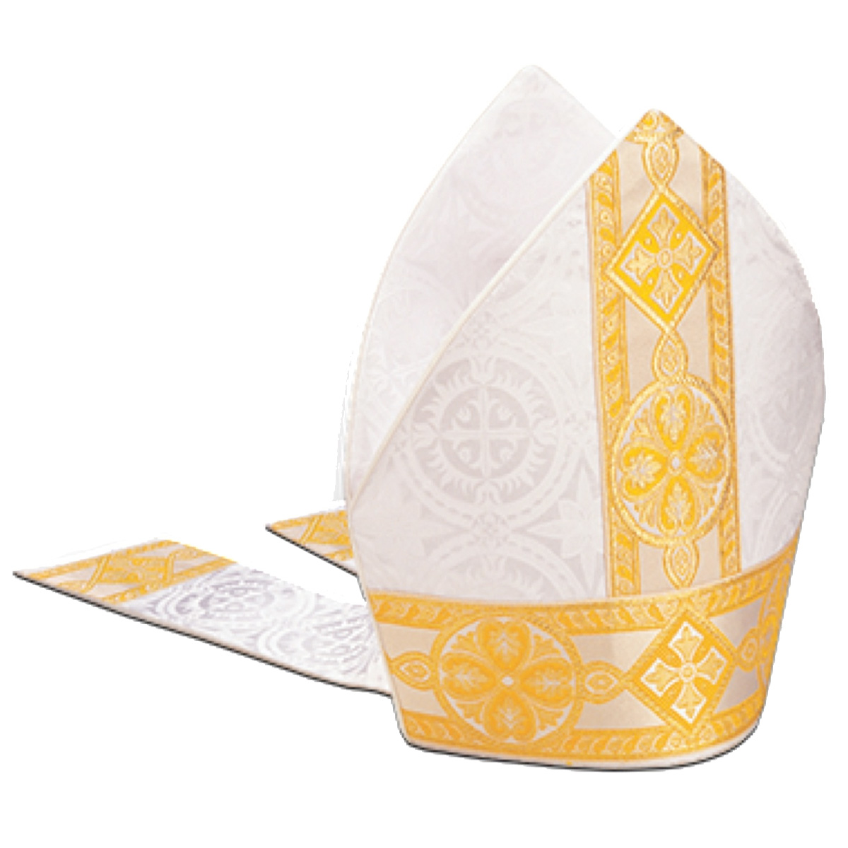
Who wears this?

Slide 3
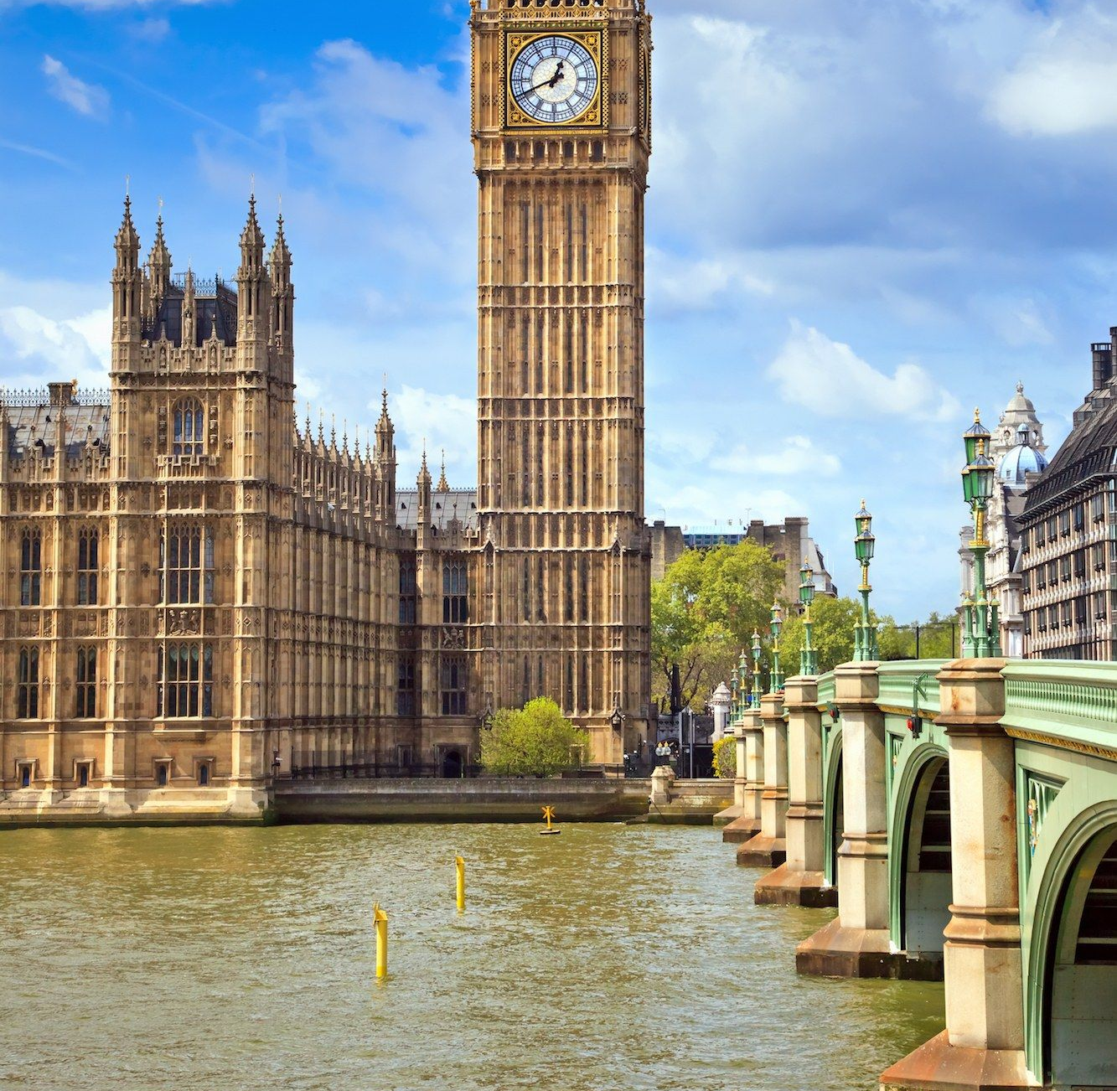
Where is this?

Slide 4
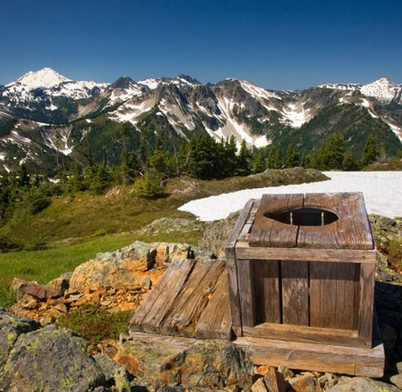
What is this?

Slide 5
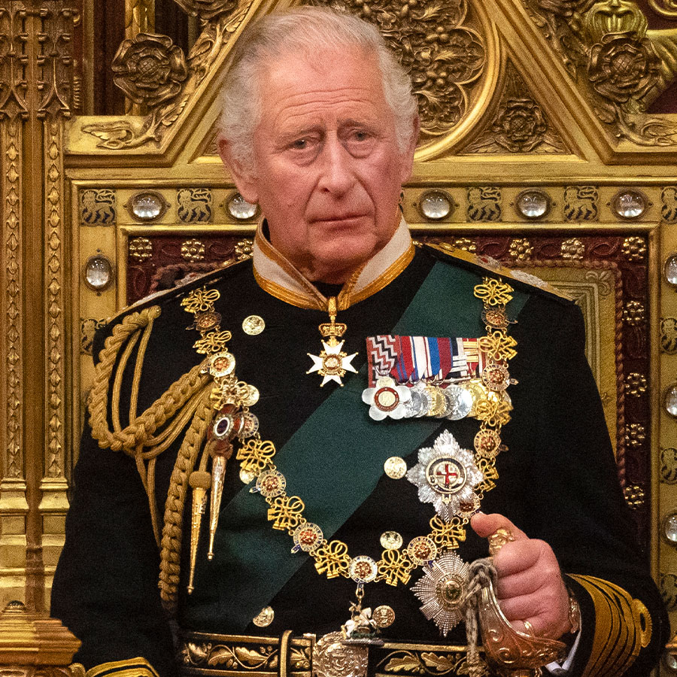
Who is this?

Slide 6
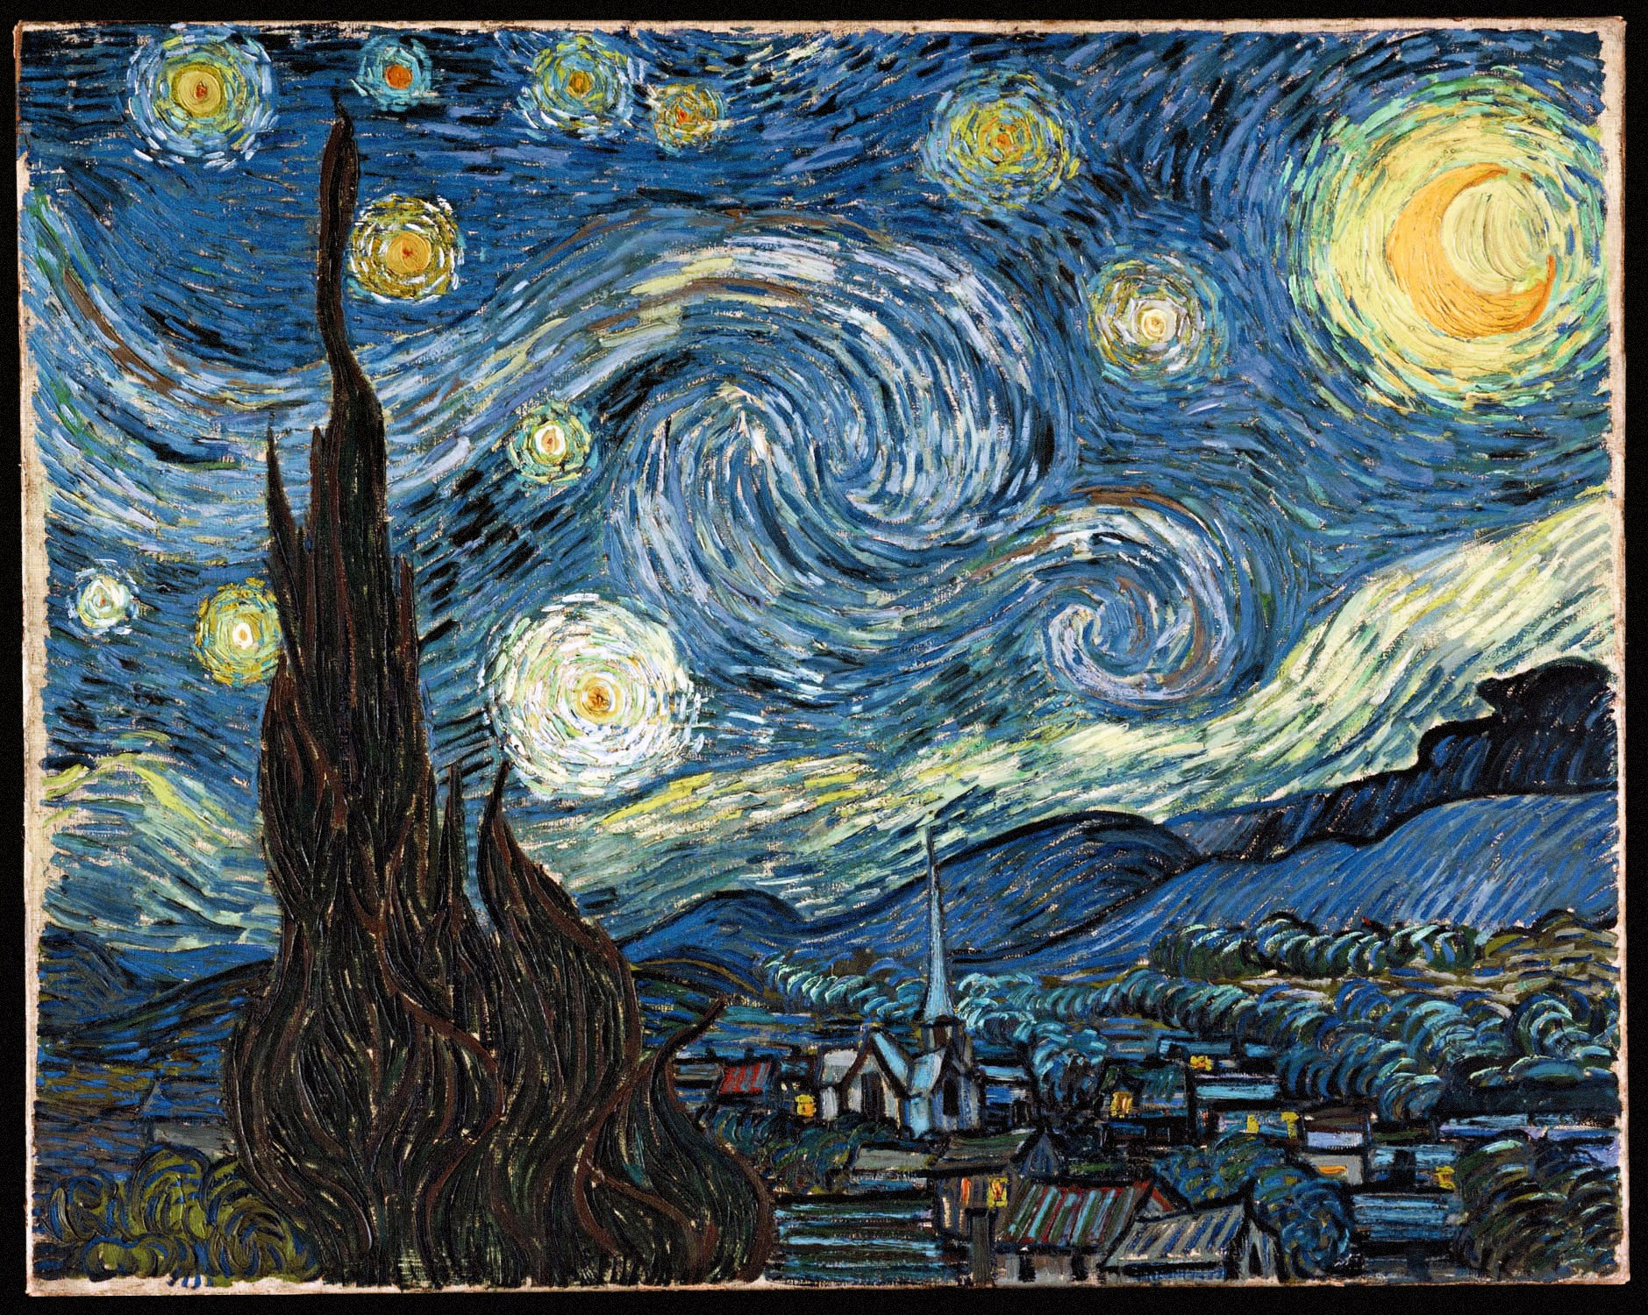
Who painted this?

Slide 7

Who sang this?

Slide 8

So where did you learn the answers?

Slide 9
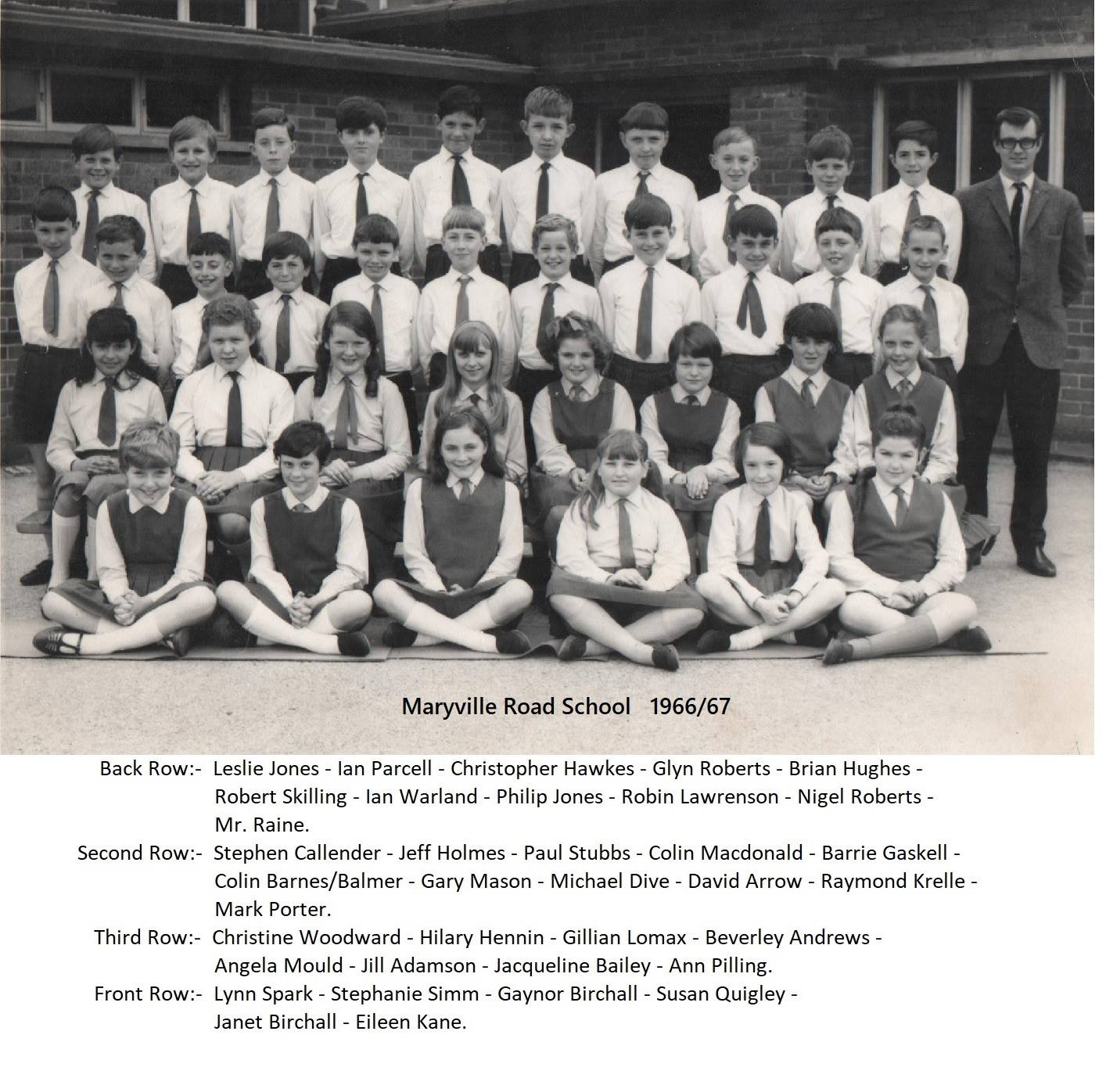
My primary school

Slide 10
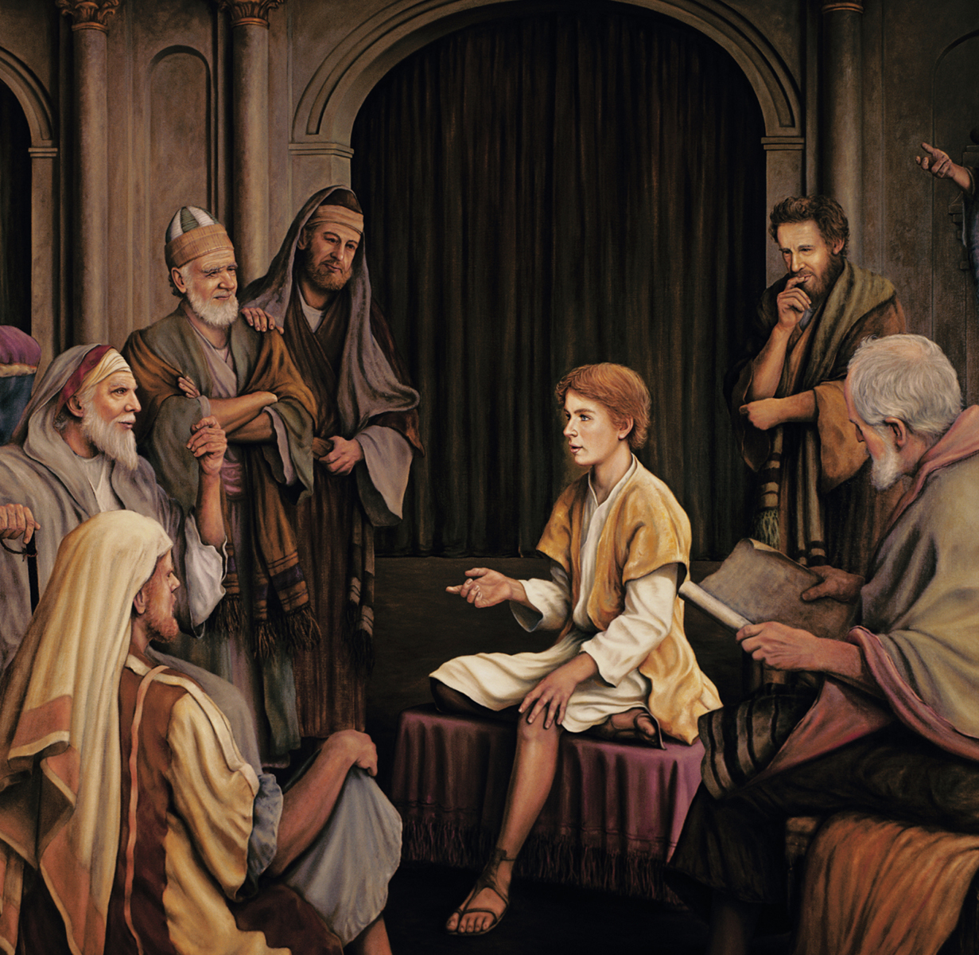
Jesus in the temple

