Slide 1
Essentials of (Classical) Pentecostalism
Simo Frestadius
Regents Theological College,
Malvern, UK
Churches Together in England, Swanwick,
29th September 2015

Slide 2
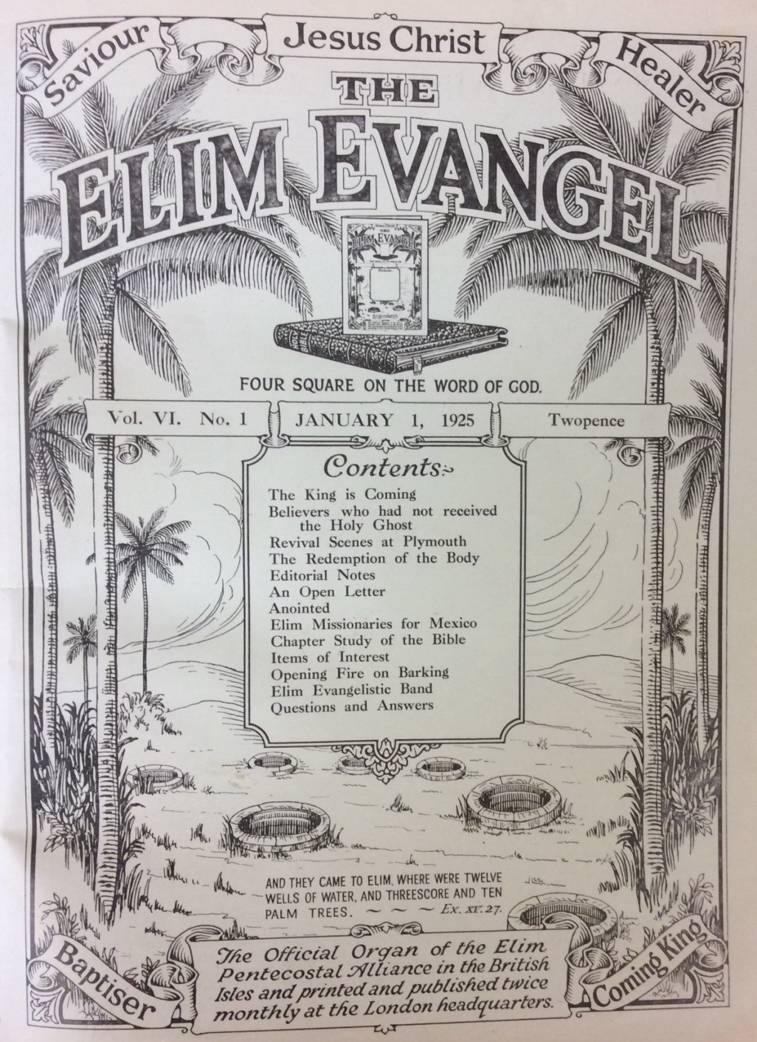
Fourfold Gospel
Jesus Christ is…
Saviour
Healer
Baptiser in the Holy Spirit
Coming King

Slide 3
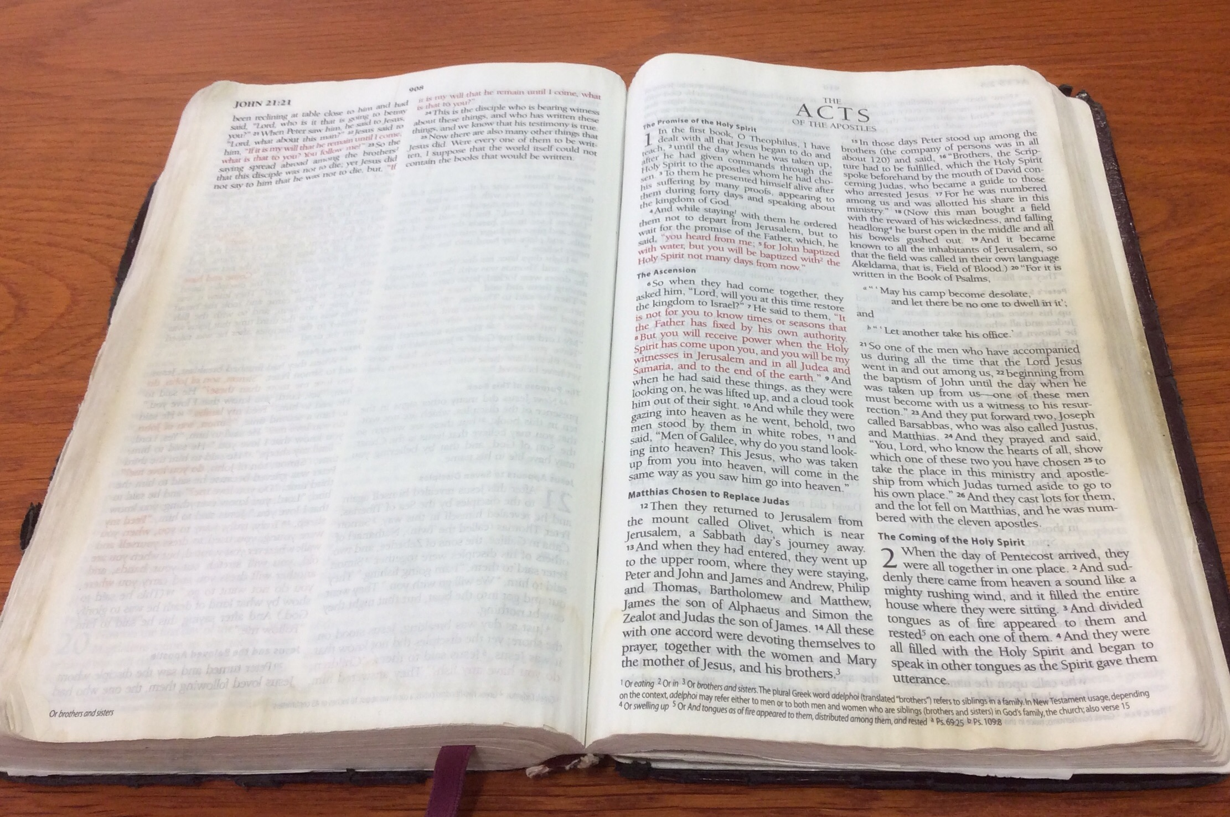
Biblical Pragmatism

Slide 4
Structural Fluidity
(http://freebigpictures.com)

